Slide 1
Children’s Speech and Language Therapy: Our Health Literacy Journey
Victoria Bailey
Specialist Speech and Language Therapist

Slide 2
Background
Children’s SLT work with children and families in North Staffordshire and Stoke on Trent
Stoke Speaks Out: an multi-agency initiative developed to tackle the high incidence of language delay identified in children in Stoke-on-Trent
A whole system approach to change: campaigning, public health messaging, training for wider children’s workforce
Supports the specialist core SLT NHS service
Notes:
Has been around since 2004 and is a whole system approach to change – campaigning, PH messaging, training for wider children’s workforce.

Slide 3
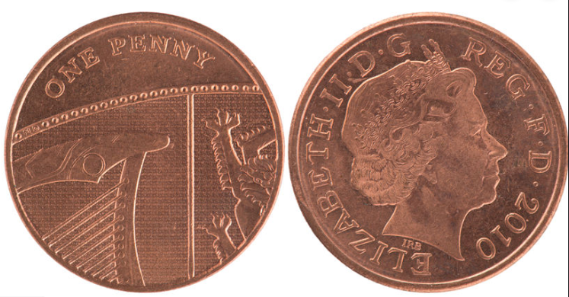
Two sides of the coin
Improving the Health Literacy of individuals
Making our service more Health Literacy friendly
Notes:
Going to talk today about how we are tackling both sides of HL

Slide 4
The start of our journey
Health Literacy Awareness Training in 2015
We learned that two major barriers to Health Literacy are
Socio-economic disadvantage
Low educational attainment
Stoke on Trent is an area of high deprivation
Below national average levels of educational attainment and therefore below national average adult literacy levels
Notes:
Ranked 13th of local authority districts with the highest proportion of their neighbourhoods in the most deprived 10 per cent of neighbourhoods nationally on the Index of Multiple Deprivation 2015
In 2015, the percentage of students in Stoke-on-Trent achieving five GCSEs grade A*-C including English and maths was 48%, compared to 57% of pupils nationally. This figure drops to just 31% of disadvantaged students in Stoke.

Slide 5
Links with children’s speech, language and communication
Young children’s language capabilities predict their later literacy skills
A child’s vocabulary at age 5 is the strongest predictor of later academic success
Children from disadvantaged backgrounds typically have a smaller vocabulary than those from more advantaged backgrounds
Notes:
There is a huge amount of research demonstrating that young children’s language capabilities predict their literacy skills (National Literacy Trust, 2019, Language Unlocks Reading). We know that these skills are crucial to children’s life chances as they will in turn impact on an individual’s Health Literacy.
Biemiller, 2003 - Vocab at age 5
White et al 1989, Hart & Risley, 2003 - 30 million word gap by age 4

Slide 6
Health Literacy resource boxes
We wanted to provide opportunities for children in Early Years to experience and use a wide range of vocabulary relating to health literacy
We created four Health Literacy resource boxes:
Going to the Dentist
Going to the Hospital
Going to the Doctors
Healthy Eating
Available on loan from the library

Slide 7
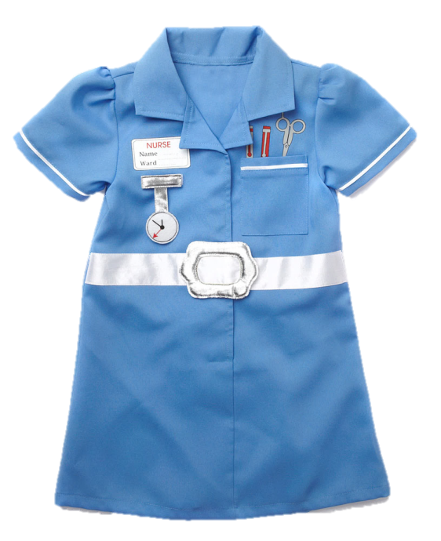
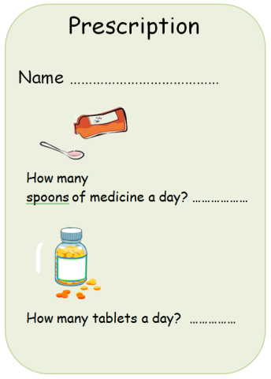
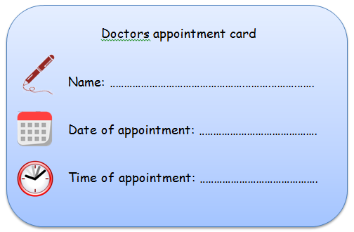
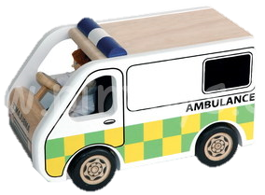
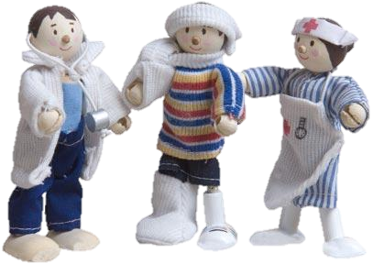
Activity sheets
Books
Vocabulary screen
Role play
Small world play
Notes:
A vocabulary screen
Activity sheets
Topic related toys/games
Books (fiction/non-fiction)
Evaluation sheets

Slide 8
Aims
Screen children’s knowledge of health related vocabulary
Provide quality ‘pick up and go’ resources to allow theming of whole classroom around topic
Immerse children in health related vocabulary in a play based and multi-sensory way – evidence based vocabulary teaching method
Provides children with a core foundation of vocabulary on which to build later learning
Provide children with a core vocabulary so they can access later teaching around health topics and consequently acquire a higher level of health literacy

Slide 9
Impact
Practitioners discovered gaps in the children’s vocabulary using the screen
Able to use this information to target vocabulary teaching using the resources
Children and practitioners enjoyed playing with the toys and resources
The boxes are regularly borrowed from the library

Slide 10
Becoming health literacy friendly
Appointed a Health Literacy lead for department
Formed a working group – Health Literacy lead and two SLTs
All members of working group attended Health Literacy Awareness training
Health Literacy lead attends HL seminars and events
Drip feed Health Literacy messages and mini training at team meetings and Quality Days – keeping HL on the agenda
Working group have formulated a Health Literacy Action Plan for the SLT department using HL Audit as a starting point

Slide 11
Health Literacy Action Plan
Introducing Teach Back
Review appointment letters sent to families
Audit leaflets and information and review readability
Review signage in clinics and encourage colleagues to look at this with fresh eyes
Staff training – key members of admin team, induction of new staff
Increase staff awareness of resources available to the public to improve their HL skills
Create a Health Literacy policy for our department

