Slide 1
Health Literacy and Children’s Services
Sue Garland – Service Manager – City Universal Services and School Aged Immunisation Services
Karen Wilson – Team Leader – Health Visiting – Stoke-on-Trent

Slide 2
About our Children’s Services
Ours services are made up of Therapies and Nursing and Mental Health
Breadth of qualifications from apprentice to Masters and above
Support families with a range of interventions from Public Health awareness, packages of care to acute intervention

Slide 3
Our Involvement with Health Literacy
Initially through the wider Public Health Agenda – bringing awareness to teams on effective communication and understanding
Following Tender process with Public Health a number of Public Health Advisory teams attended training and returned full of enthusiasm
A chance conversation with Mike in November 2017
Starting with baby steps (which continue) and enlisting the support of our Managing Director.

Slide 4
Our road to becoming Health Literacy Friendly…………….
A number of Health Visitor/School Nurses and Therapists undertaking bespoke HL training
Service Manager undertaking the HL training with corporate colleagues to ensure organisational understanding of HL
Starting to review our documentation with service users
Putting all documents through SMOG to simplify them
Undertaking the audit to identify next steps and areas of action

Slide 5
A sample of what we have done so far…………………

Slide 6
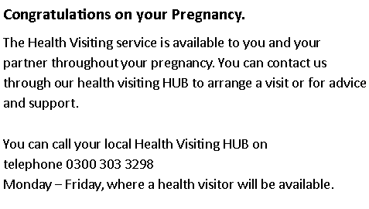
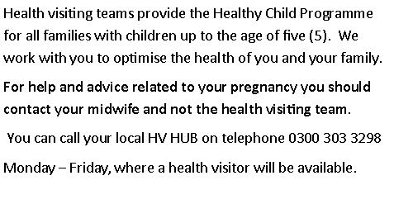
Antenatal Advice and Support from the Health Visiting Service
Information Leaflet
Simple Measure of Gobblydegook score 17.6

Slide 7
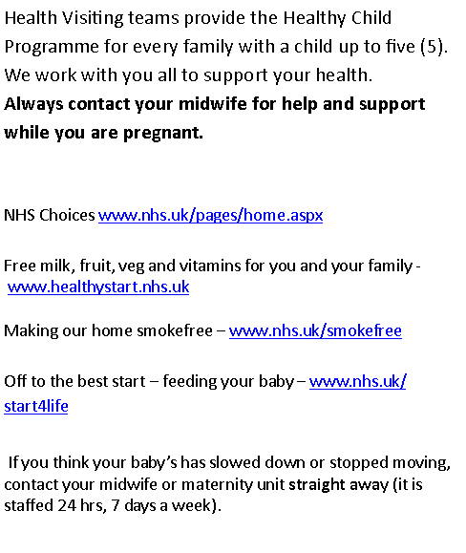
Simple Measure of Gobblydegook 8.2

Slide 9
Children’s Speech and Language Therapy
Over to Victoria……………….

Slide 10
Children and Families Care Group Strategy –
Originally lots of long words
Very high level
Difficult to understand

Slide 11
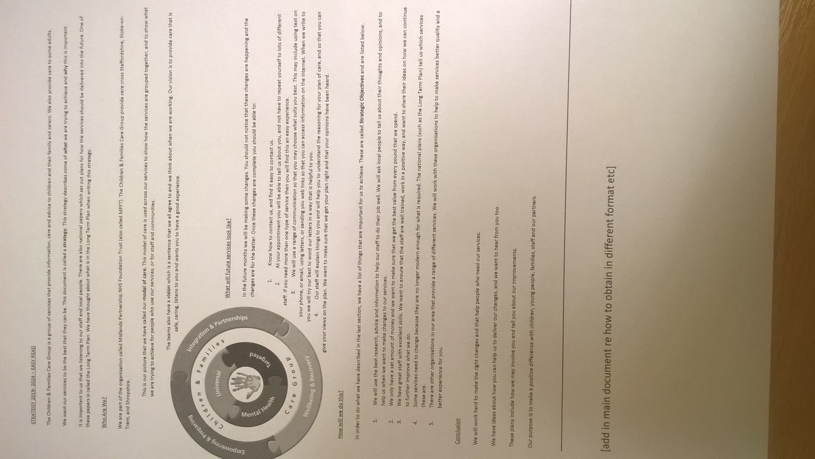
Developing Our Strategy

Slide 12
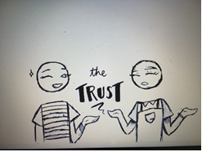
Strategy in Film
Service user involvement
Senior Leadership Investment

Slide 13
Next Steps
Evaluate the impact of changes so far in our teams
Identify a Senior Member of the Leadership team to be our HL champion for Children’s Services
Develop a Children’s Services Health Literacy Policy
Embed HL into the Children’s Strategy
HL Train the Trainer to roll out to the wider workforce ( 4 sessions planned this financial year

Slide 14
Any questions

