Slide 1
Adolescent Mental Health Literacy Current Challenges and Inconsistencies
Rosie Mansfield
@RMansfieldUoM

Slide 2
Overview
Department for Education, Education for Wellbeing Programme
Evolution of term mental health literacy
Criticisms of the mental health literacy construct
New thinking
Systematic literature review findings – existing conceptualisation and measurement of mental health literacy in adolescent research

Slide 3
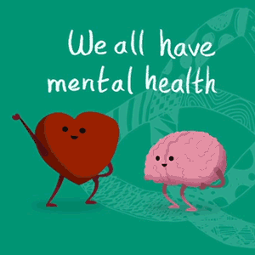
World Mental Health Day 2019 10th October
‘Sometimes we say we’re fine when we’re not’ (Time to Change)

Slide 4
Notes:
As part of our ‘You’re never too young to talk mental health’ campaign, we held 4 regional workshops where we launched our ‘Talking Mental Health’ animation and teacher toolkit, aimed at years 5 and 6 pupils.

Slide 5
Notes:
Adds significant pressure on the school workforce without sufficiently increasing resources
A lack of focus on prevention and promotion and early intervention
A lack of acknowledgement for the adverse effects of the current education system on mental health and wellbeing
Unambitious and unfair rollout with long timeframes and a small number of trailblazer areas

Slide 7
AWARE
Hayes, D., Moore, A., Stapley, E., Humphrey, N., Mansfield, R., Santos, J., … Deighton, J. (2019). School-based intervention study examining approaches for well-being and mental health literacy of pupils in year 9 in England: study protocol for a multischool, parallel group cluster randomised controlled trial (AWARE), BMJ Open, 9.
INSPIRE
Hayes, D., Moore, A., Stapley, E., Humphrey, N., Mansfield, R., Santos, J., … Deighton, J. (2019). Promoting mental health and wellbeing in schools: examining Mindfulness, Relaxation and Strategies for Safety and Wellbeing in English primary and secondary schools: study protocol for a multi-school, cluster randomised control trial (INSPIRE), Trials (in press)

Slide 8
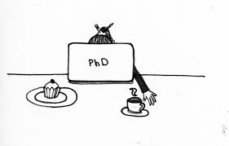
My pHd
Critical evaluation of theory and practice relating to school-based, mental health literacy interventions and their evaluation
SLR of current conceptualisation and measurement of MHL in research with adolescents
Psychometric validation of a MHL related measure – stigma behaviour with a adolescent sample
Multi-level model exploring school and individual-level predictors of educators’ MHL and perceived capacity to support pupils mental health and wellbeing
A qualitative investigation of the process of importing and implementing a MHL intervention in UK classrooms: perceived social validity and cultural transferability
Social validity as a predictor of implementation

Slide 10
Can people tell that someone is mentally ill?
Yes/No

Slide 11
Generalised anxiety disorder does not run in families
True/False

Slide 12
Major depression is a curable illness
Yes/No

Slide 13
The symptoms of mental illness are caused by abnormal functioning of the brain
True/False

Slide 14
Can people tell that someone is mentally ill?
No
Generalised anxiety disorder does not run in families
False
Major depression is a curable illness
No
The symptoms of mental illness are caused by abnormal functioning of the brain
True

Slide 15
Mental Health literacy (MHL) definitions
‘knowledge and beliefs about mental disorders which aid their recognition, management or prevention”
(Jorm et al., 1997, p. 182)
the ability to recognise specific disorders or different types of psychological distress;
knowledge and beliefs about risk factors and causes;
knowledge and beliefs about self-help interventions;
knowledge and beliefs about professional help available;
attitudes which facilitate recognition and appropriate help-seeking and
knowledge of how to seek mental health information’ (Jorm, 2000, p.396).
More recent additions to the domains include early recognition, prevention and mental health first-aid skills to support others (Jorm, 2012).
understanding how to obtain and maintain positive mental health;
understanding mental disorders and their treatments;
decreasing stigma related to mental disorders and
enhancing help-seeking efficacy (knowing when and where to seek help and developing competencies designed to improve one’s mental health care and self-management capabilities’ (Kutcher, Wei & Coniglio, 2016, p.155).
Notes:
“Health literacy implies the achievement of a level of knowledge, personal skills and confidence to take action to improve personal and community health by changing personal lifestyles and living conditions. Thus, health literacy means more than being able to read pamphlets and make appointments. By improving people’s access to health information, and their capacity to use it effectively, health literacy is critical to empowerment.” WHO 1998. Tiered models of HL that include (generic skills applied by people within health care environments), conceptual HL (generic skills applied in social contexts), and HL as empowerment for people in social and political contexts. the competencies needed by people to help obtain and maintain health and identify illness; understanding how and where to access and how to evaluate health information and health care; understanding how to properly apply prescribed treatments; and, obtaining and applying skills related to social capital, such as understanding rights related to health and health care and understanding how to advocate for health improvements.^{4,6} Further, HL is understood necessarily to be developmentally appropriate; contextually applied; involving multiple related stakeholders; and, available through existing institutional and social vehicles, such as schools, the workplace, and mass media.^{4,6,12}

Slide 16
Criticisms
The MHL field takes a predominantly mental-ill health approach, commonly measuring the ability to recognise mental disorders from a vignette based on psychiatric labels (e.g. Read et al., 2006; O’Connor et al., 2014; Chambers et al., 2015).
Stigma reduction is the most common aim of school-based MHL interventions (Wei et al., 2013), therefore this model of MHL appears to cause conflict.
The difference between literacy about mental disorders and the ability to seek out, comprehend, appraise and apply information relating to the complete mental health state is an emerging point of discussion (Kusan, 2013; Bjørnsen et al., 2017).
Notes:
stretched definitions are causing inconsistencies in measurement and some suggest that MHL should not be a multi-dimensional construct but a multi-construct theory.
https://www.who.int/healthpromotion/health-literacy/en/

Slide 17
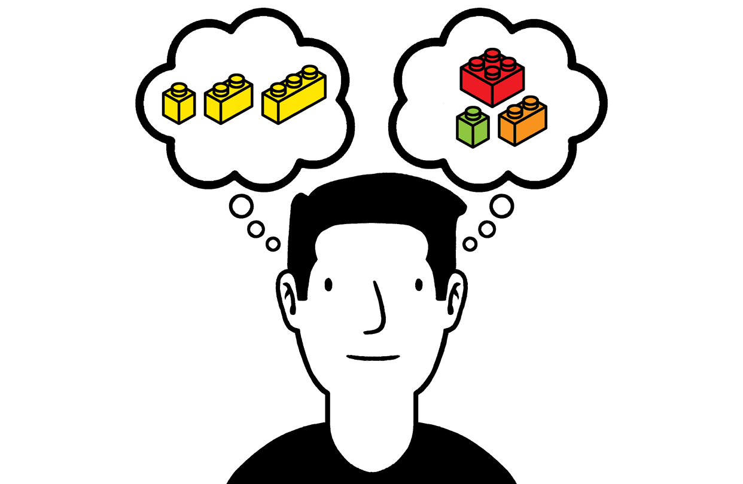
New thinking
Spiker and Hammer (2018) suggested that stretched definitions are causing inconsistencies in measurement and that MHL should not be a multi-dimensional construct but a multi-construct theory.
Furthermore, school-based mental health promotion approaches that account for children’s social, cultural and political contexts, encourage a more dynamic understanding of MHL theory and practice (O’Toole, 2017).
Notes:
stretched definitions are causing inconsistencies in measurement and some suggest that MHL should not be a multi-dimensional construct but a multi-construct theory.

Slide 18
Challenges of Health Literacy
‘Health literacy as one multidimensional, complex and heterogeneous concept’ (Sørensen & Pleasant, 2017).
‘As the definition of health literacy expands, so, too, does the scope and depth of health literacy research, practice implementation and public policy’ (Rudd,2017).
Importance of accounting for developmental stage and social context for CYP (Broder et al., 2017).
Use of adult measures with child and adolescent samples and lack of CYP involvement in measure development.
Notes:
MHL behind – going through the same evolution as health literacy

Slide 19
A Systematic Literature Review of Existing Conceptualisation and Measurement of Mental Health Literacy in Adolescent Research:
Current Challenges and Inconsistencies
Rosie Mansfield* MPhil, Praveetha Patalay PhD and Neil Humphrey PhD

Slide 20
research questions
1. What are the most common study contexts, designs and aims?
2. How is MHL conceptualised e.g. do articles account for adolescents’ developmental phase or the school context, and is it a predominantly mental-ill health approach?
3. What are the most commonly measured domains of MHL, and do these vary by study design and definition usage?
4. To what extent do articles use measures that have evidence of validity for use with adolescent populations?
5. Is there enough methodological homogeneity in the field to conduct meta-analyses?

Slide 21
Method
Five databases (e.g. PsycINFO) and grey literature were searched (1997-2017).
Included articles presented quantitative self-report data for at least one MHL domain with an adolescent sample (10-19 years) and used the term ‘mental health literacy’.
General and diagnosis-specific MHL articles
Definitions, methodological and contextual data were extracted.
An assessment of all MHL related measurement tools included in the identified articles was conducted to assess methodological homogeneity and any validated scaled.

Slide 22
Results
206 articles identified that presented extractable data for at least one domain of MHL with an adolescent sample
115 removed that did not explicitly use the term ‘mental health literacy’ or a diagnosis specific equivalent e.g. depression literacy
91 articles included in the final set!!

Slide 23
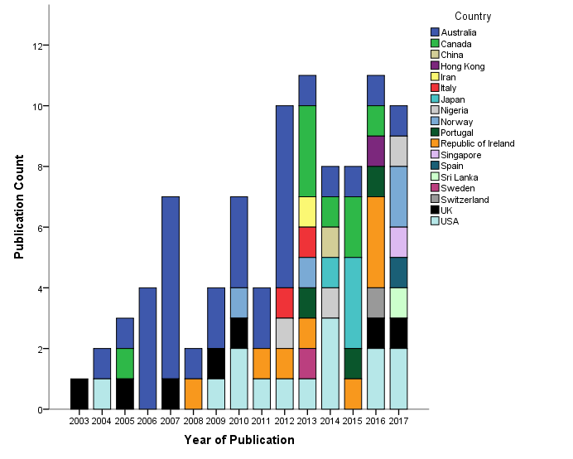
Results: context, design and aims
The countries that have published the majority of research (2003-2017): Australia (34%), USA (15%), Canada (9%), Republic of Ireland (9%) and the UK (8%).
Population (64%)
71% school-based
67% had the primary aim to describe levels of MHL
15 articles predicted specific MHL domains or relationship between domains and 4 articles were scale validation papers.
Intervention (36%)
94% school-based
76% aimed to evaluate the intervention

Slide 24
Results: conceptualisation
Under half of the articles that used the term ‘mental health literacy’ defined it.
Few definitions referred to vary degrees of psychological distress as well as mental disorders as in the original definition, and in the majority of cases ‘knowledge and beliefs’ was replaced with knowledge only.
Generally, definitions were taken from adult literature and not adapted for developmental stage or social context of adolescent
Regardless of whether a definition was provided …..
Conceptual confusion about whether different domains are part of the construct or are predicted by the construct e.g. mental illness stigma and help-seeking intentions.

Slide 25
Results: measurement
A mental-ill health approach continues to dominate the field, with few articles assessing knowledge of mental health promotion.
43% of articles included items relating to general MHL, but various terminology was used e.g. mental illness, mental problem, mental health issue
74% included items relating to depressive disorders, 46% psychotic disorders, 31% anxiety, however of these 86% related to social phobia.
63% used vignettes based on diagnostic criteria and few used comparator vignettes i.e. varying degrees of distress, physical/spiritual health problems.
Notes:
Leighton (2009) conceptual confusion amongst CYP about different mental health terminology.

Slide 27
41%
33%
36%
25%
14 vs. 31 %
55%
70%
10 vs. 55%
34 vs. 63 %
55 vs. 10%

Slide 28
Results: measurement
4% of articles were validation papers (Hart et al., 2014; Campos et al., 2016; Bjørnsen et al., 2017; Pang et al., 2017).
24% developed some items or scales for the purpose of their study (not validated)
43% based their items on Jorm and colleagues MHL surveys, however the survey is not validated as a complete scale and researchers modified and selected items.
Notes:
Ranging from specific domains Pang to MHL scales to positive MHL.
Adolescent Depression Knowledge Questionnaire (ADKQ) Hart et al. 2014
R-AQ pinto et al.
Link 1999 social distance scale
The Depression Stigma Scale (DSS)
Opinions about Mental Illness Scale (OMI)
Attitudes Toward Serious Mental Illness Scale–Adolescent Version (ATSMI-AV) Subjective Social Status Loss Scale
General Help Seeking Questionnaire (GHSQ)

Slide 29
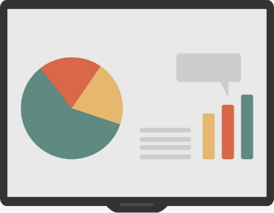
Results: summary
Increasingly stretched definitions of MHL have led to:
Conceptual confusion (e.g. is stigma a domain or is it something that MHL predicts?)
Methodological inconsistency
A lack of validated adolescent measures
Meta-analysis not possible

Slide 30
How do we know if adolescent population MHL is increasing?
How do we compare global levels of adolescent MHL?
How do we know if school-based MHL interventions are effective?

Slide 31
Implications/conclusions
Many studies developed or adapted items to fit the cultural context, in particular, knowledge items – should we be aiming to measure these things in a standardised way?
Future research should aim to assess knowledge and skills for seeking out, comprehending, appraising and applying information relating to the complete mental health state.
Researchers should focus on improving the measurement of specific domains in the adolescent population, acknowledging them as constructs in their own right.
With good measures, more can be understood about mechanisms for change in improving help-seeking behaviours and adolescent mental health.
Notes:
Skills for critical appraisal of mental health information and knowledge about rights in healthcare and controversies and disagreements in the field. We need to be encouraging CYP to be advocates for education systems that are mentally health and well funded services but teachers up to now are expected to remain politically neutral.

Slide 32
Related articles
Mansfield, R., Patalay, P., & Humphrey, N. (2019). A systematic literature review of existing conceptualisation and measurement of mental health literacy in adolescent research: current challenges and inconsistencies (under review)
Mansfield, R., Humphrey, N., & Patalay, P. (2019). Psychometric validation of the Reported and Intended Behavior Scale (RIBS) with adolescents. Stigma and Health (in press)
Demkowicz, O., Ashworth, E., Mansfield, R., Stapley, E., Moore, A., Burrell, K., … Wolpert, M. (2019). Children and young people’s experiences and perceptions of engaging with mental health measures for research (submitted)

Slide 33
Thank you
Any questions?
rosie.mansfield@postgrad.manchester.ac.uk

